Slide 1

Evaluating A Effective Restaurant Location in Manhattan

Slide 2

WHy this Matters?
New York City is known as the financial capital of the world with residents making $93,000 per capita annually.
Almost 1 in 38 people living in the United States lives in New York City, making New York City the most densely populated city in the U.S.
New York's economy is almost the same size as Canada's and projected to overtake the GDP of Tokyo in 2035
As we can see, NYC is a wealthy area to build your restaurant and the city is still growing economically.
Evaluating where (I.e. what location) to start a business lends to a highly successful and profitable business

Slide 3

Data extraction
Filter out all the Manhattan neighborhoods from the "new_york_dataset.csv" file.
Utilize the Folium to visualize the neighborhood to be dealt with.
Using the Foursquare API, we query the venues from all the neighborhoods of Manhattan and further visualize the venues that are restaurants and the venues that are not.

Slide 4
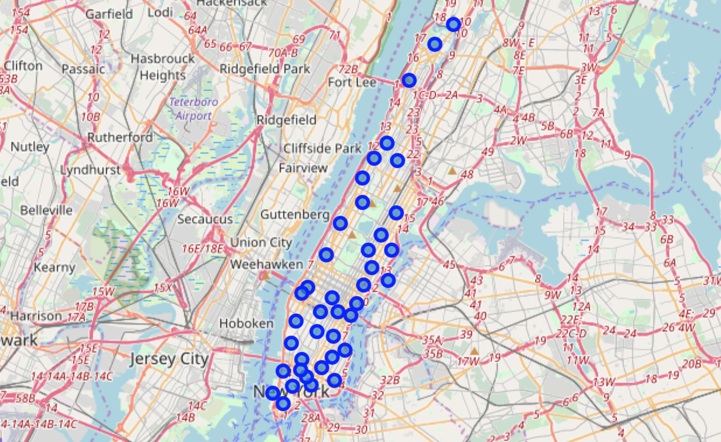
Neighborhoods in Manhattan

Slide 5
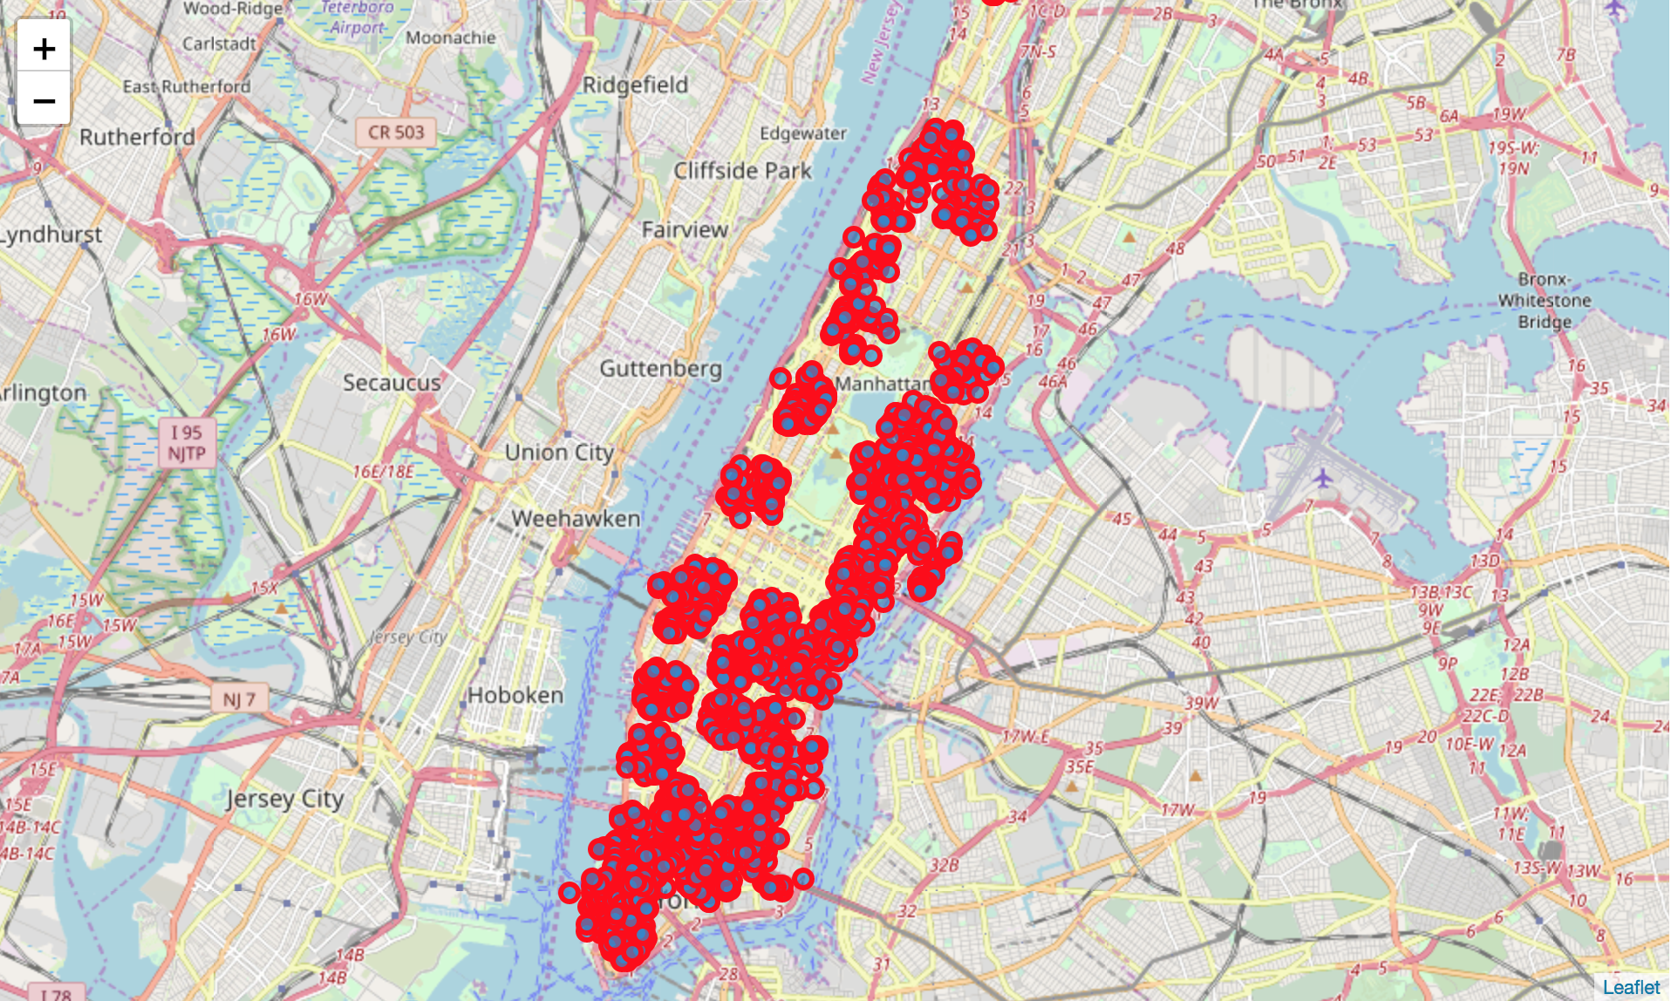
Venues in Manhattan (queried from foursquare)

Slide 6
Data PREPARATION AND Assumption
Assumption: recommendation on a good location for restaurant based only on restaurant location
Data is labeled in a binary format with "Yes" and "No" , where "Yes" means that the venue is a restaurant and "No" means that the venues is not a restaurant.

Slide 7
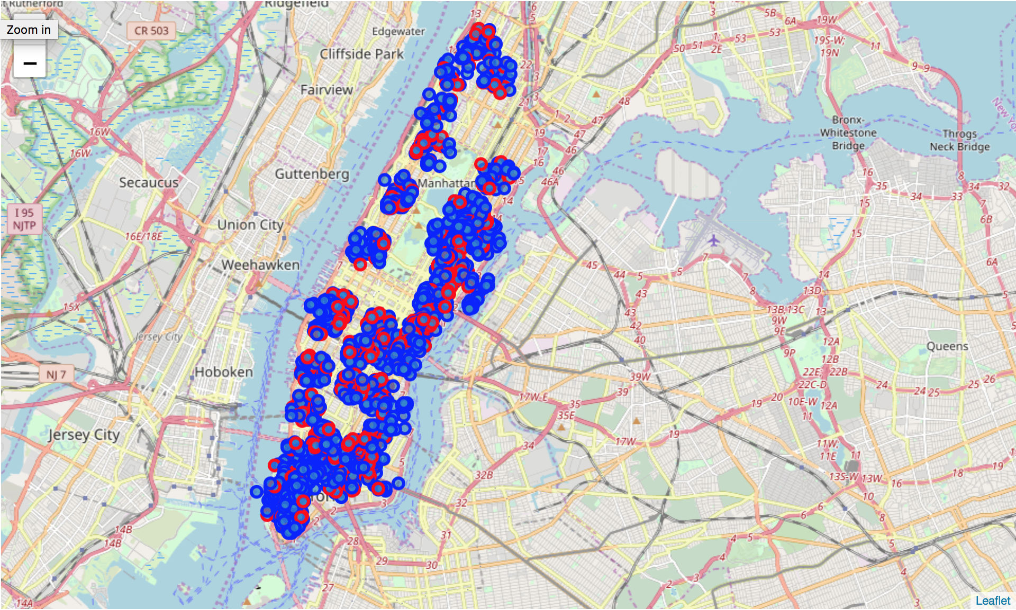
Labeled (Clean) Data

Slide 8
Methodology
K nearest neighbors : 1 to 20 nearest neighbors will be used find the best accuracy.
Decision trees : The algorithm will be checked with decision tree depths 1 to 10 to find the best accuracy.
Support vector machines : will use the "rbg" solver.
Logistic regression : will use the "liblinear" solver.

Slide 9
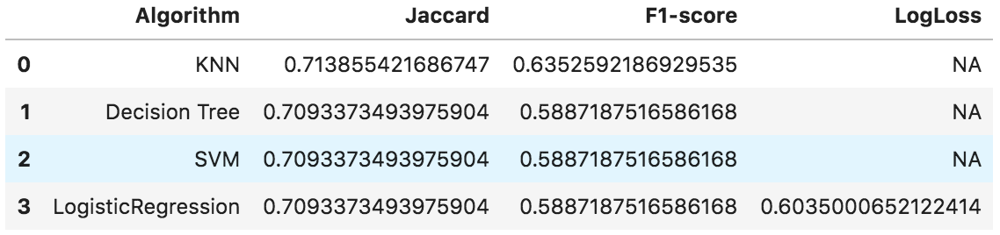
Results

Slide 10
Discussion and Conclusion
Considering that the 1/3 of the venues are restaurants, there might be a bias from the number of non restaurant venues. Furthermore, there are venues types that are eateries or restaurants such as cafes, sandwich shops, etc that could also fall into the category of "restaurants."
Since we are making a evaluation of if a plot is a good fit to start a restaurant on, in the future, it might we good to collect financial information, traffic information, etc to make a proper judgement on good fit.

Slide 11

Thank You!

